Slide 1
Goal Setting
Session 2
College Prep
Mr. Gordon
jgordon@bisdtx.org

Slide 2
Upcoming Events
hi

Slide 3
Short-Term Goals
There are short-term and long-term goals.
Let’s define short-term as anything within six months.
Examples may include:
Saving $200 for a trip in July
Getting your driver’s permit in December
Or getting an A on a test next week.
hi

Slide 4
Long-Term Goals
Long-term can be six months to five years.
Examples may include:
Getting accepted and attending Texas A&M University
Saving $2000 to buy a car
Or traveling to Japan.
hi

Slide 5
How to Accomplish Your Goals
The easiest way to accomplish a goal up is to break it up into smaller parts and set time limits.
Let’s say your short-term goal is to get your driver’s license by Spring Break. Some steps could be:
Be at least 15 years old.
Complete the application and provide proof of identity.
Complete the written exam.
Pay the $16 learner’s permit fee
hi

Slide 6
How to Accomplish Your Goals
Now let’s say your long-term goal is to get accepted and attend Texas A&M University. Some steps could be:
Practice and take the SAT exam.
Gather letters of recommendations.
Complete the application process and pay the $75 application fee.
Pack your bags.
hi

Slide 7
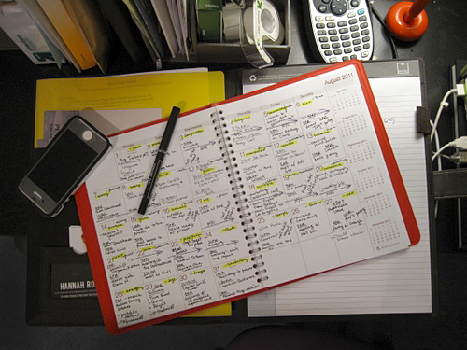
Assignment
Brainstorm and jot down three short-term and two long-term goals.
Your goals must be written down. Take a picture on your phone.
hi

